Slide 1
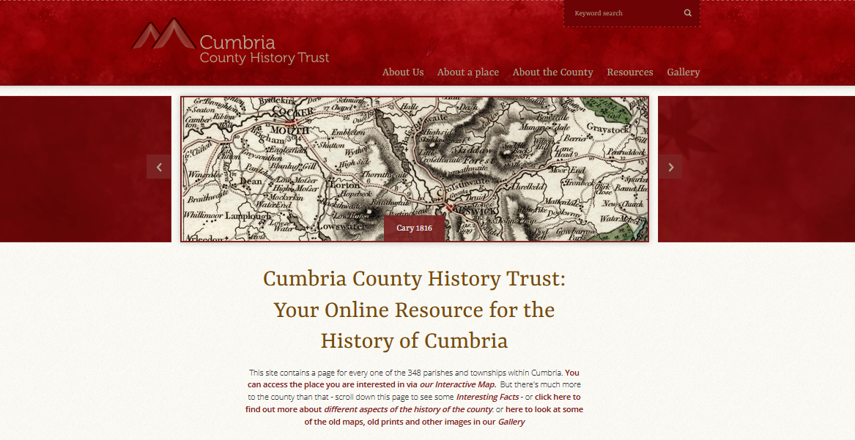
The Cumbria County History Website –
An Introduction https://www.cumbriacountyhistory.org.uk

Slide 2
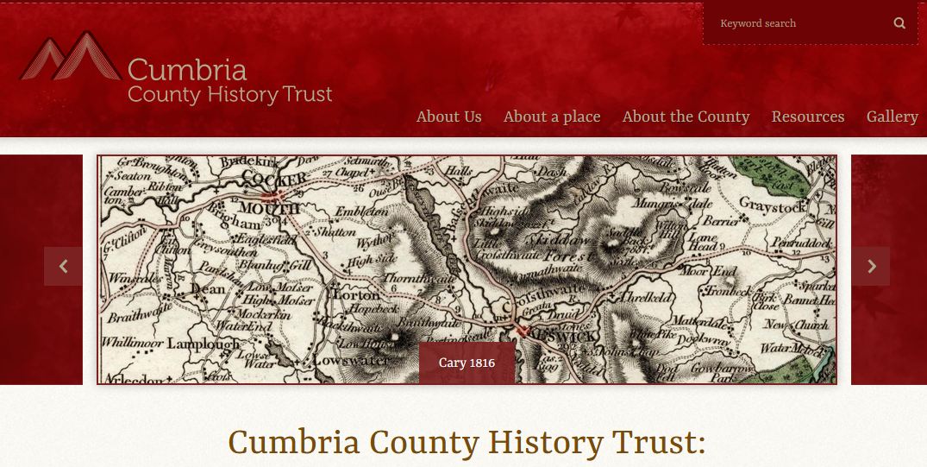
The ‘Home’ or ‘Landing Page’
1) Search engine
(2) Note the five tabs to click on to take you to the other pages
(3) A slide show of images of the county – these change randomly from time to time
(4) Scroll down from here for more info about the Trust, for a random ‘Interesting fact’, for latest Posts, and for recent Tweets

Slide 3
Click on the ‘Gallery’ tab on the Home Page, then scroll down to see the wide range of visual material available for free download

Slide 4
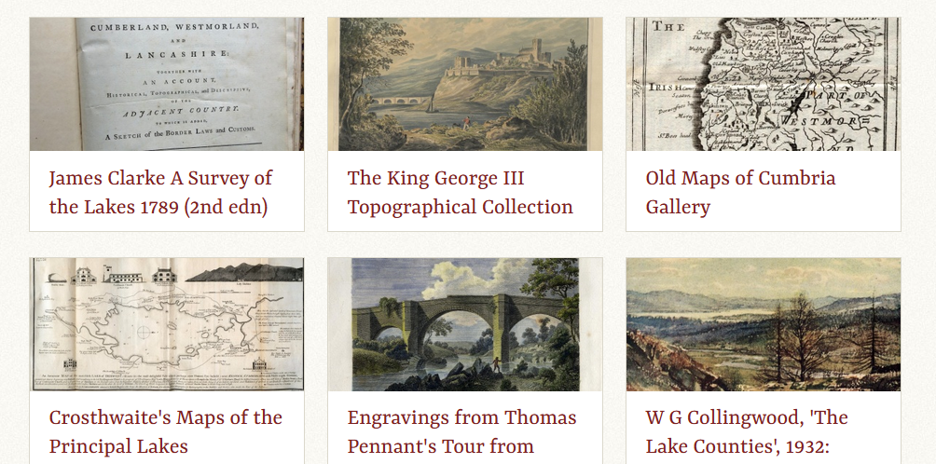
Click on the ‘Gallery’ tab on the Home Page, then scroll down to see the wide range of visual material available for free download
2) As an example click here to open the Old Maps gallery

Slide 5
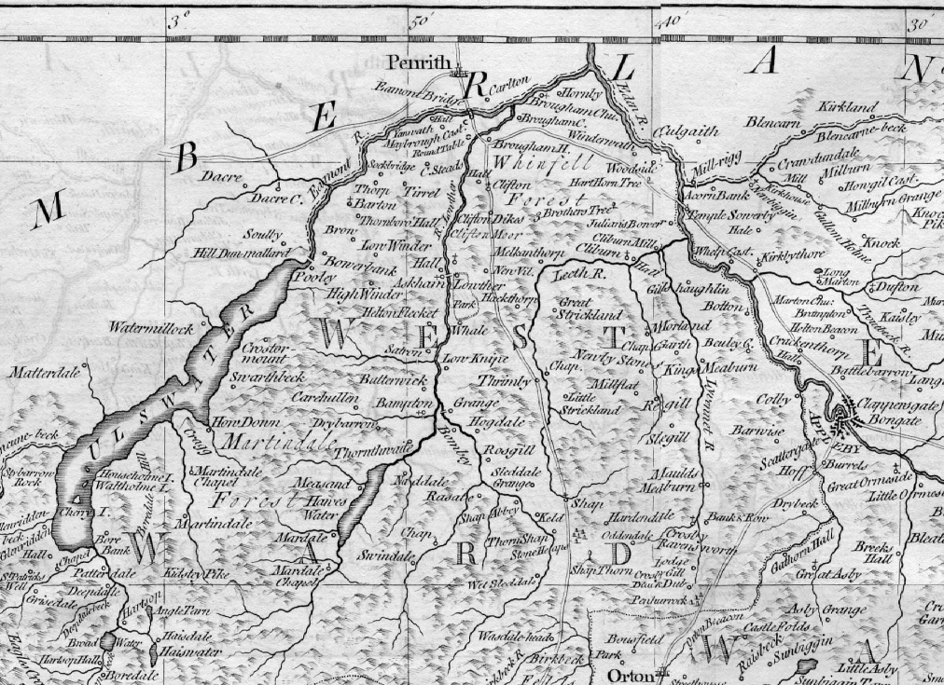
Kitchin’s map of Westmorland, 1777, is just one of the maps available – you can download and print it, or save it to your own computer

Slide 6
Click on the ‘Resources’ tab on the Home Page, then scroll down to see the wide range of background material to help you with your own researches

Slide 7
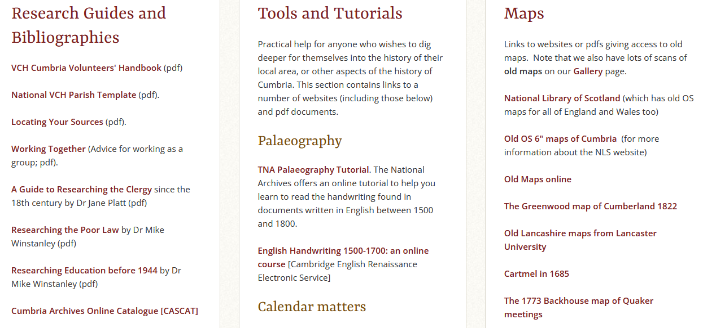
Click on the ‘Resources’ tab on the Home Page, then scroll down to see the wide range of background material to help you with your own researches

Slide 8
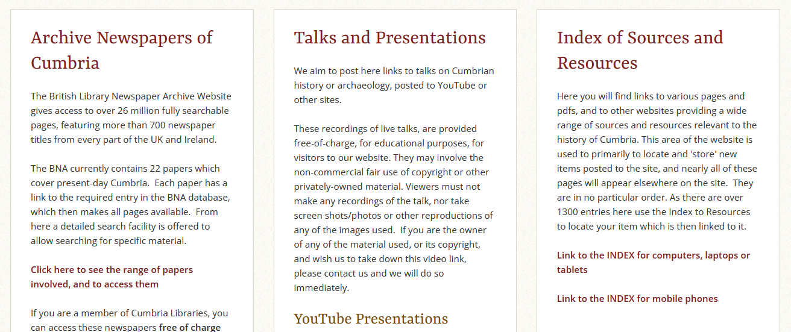
These are just a few more of the Resources available, including a full Index as to what is available

Slide 9
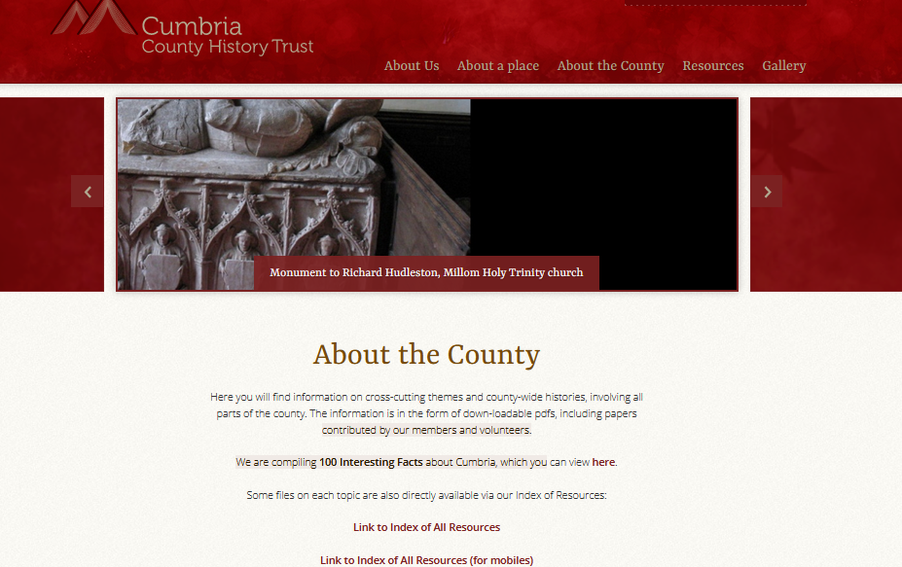
1) Click on ‘About the County’ to go to a place full of background and general histories about different aspects of Cumbria’s history
2) Scroll down to access all the different resources

Slide 10
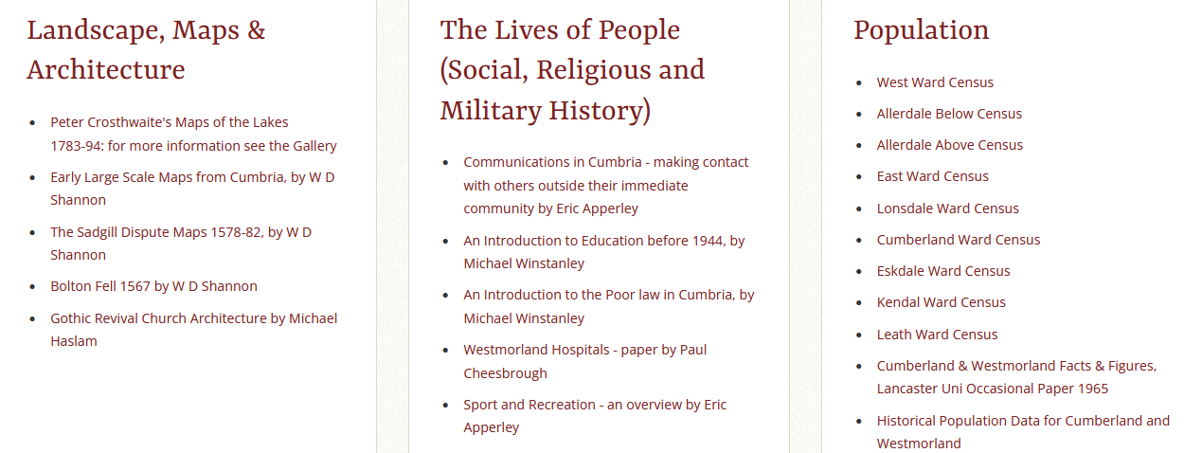
For example, this page allows you to access details of the Population of the place you are interested in: Click on the relevant Ward

Slide 11
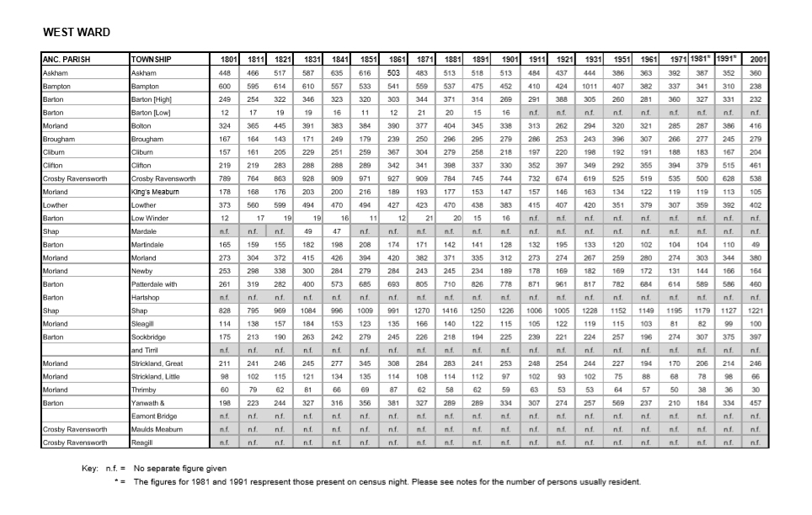
This will bring up a downloadable pdf showing the population of Askham (and everywhere else in West Ward) every ten years from 1801 to 2001

Slide 12
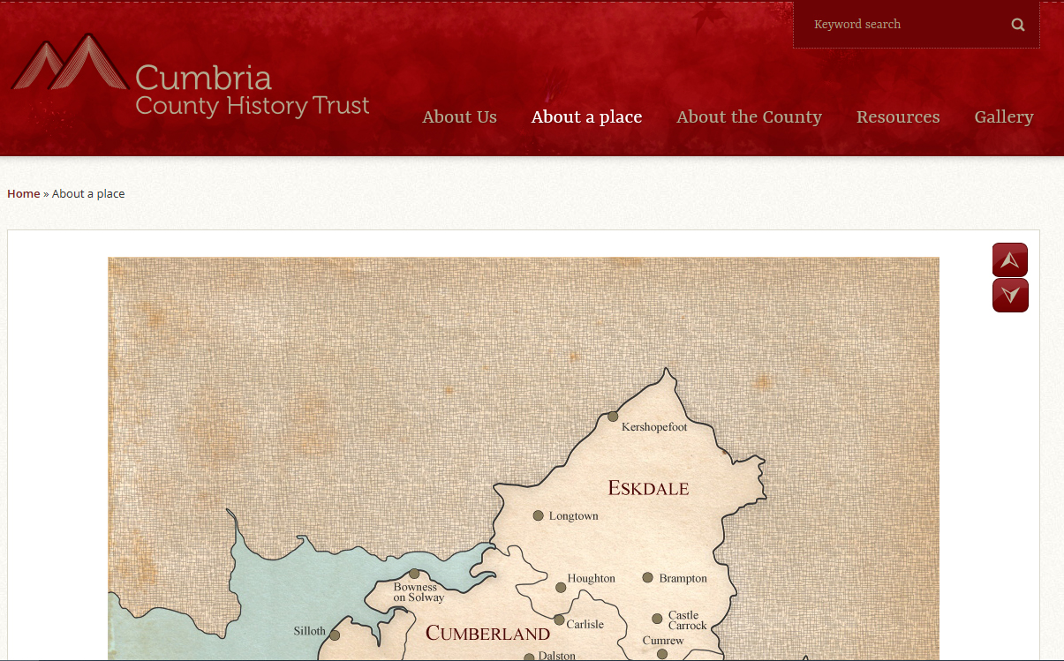
Click ‘About a Place’ to bring up the map, to allow you to access any place in the county
Click ‘Expand’ on the map to open it, then click on the relevant ward

Slide 13
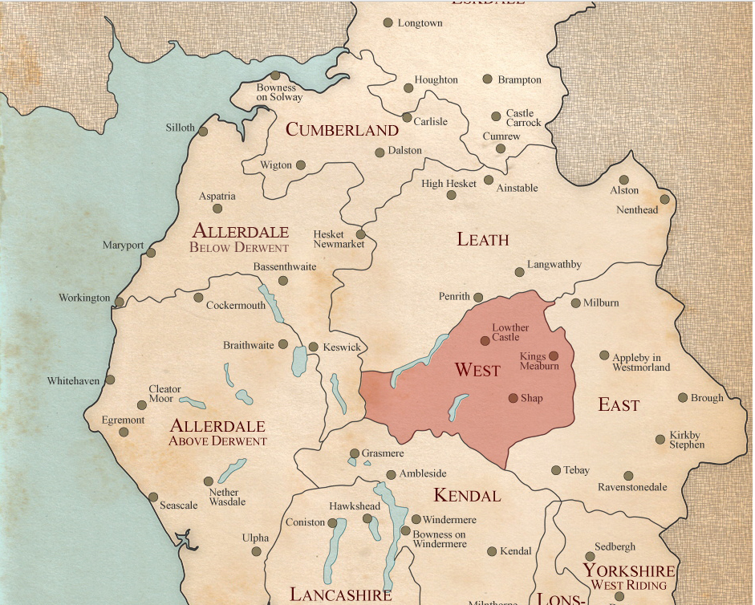
Then click within the highlighted area to bring up the Ward map

Slide 14
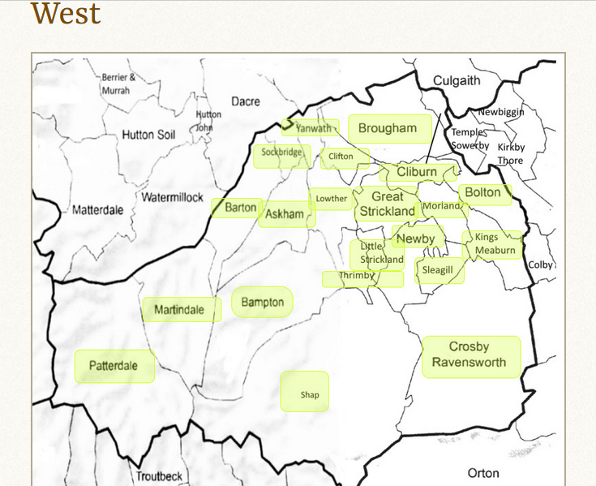
Then click on the township you are interested in.
If you don’t know which ward it’s in, you can always access the alphabetical township list from the ‘About a Place’ page

Slide 15
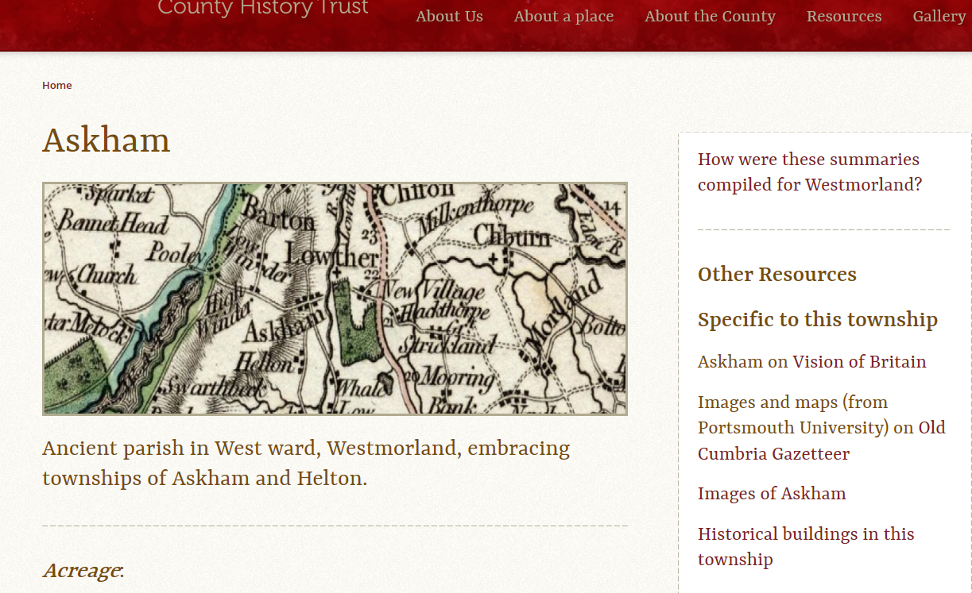
1) Scroll down on the left hand side for a full ‘Gazetteer’ entry for the township
2) Check out the right hand side for lots of other information specific to the township

Slide 16
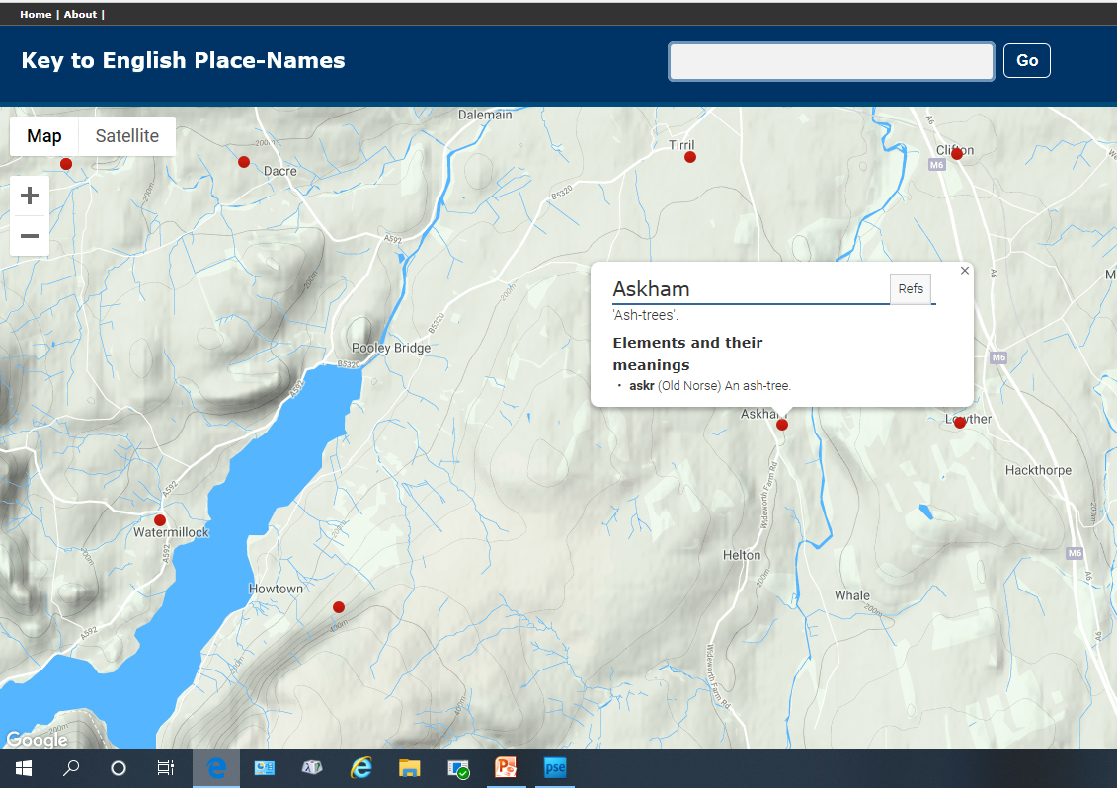
Bottom left on the township page you will find a link that takes you through to the English Place-Names website, to explain the meaning, and the language of the name

Slide 17
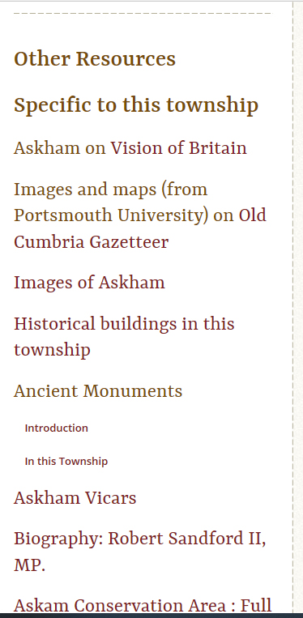
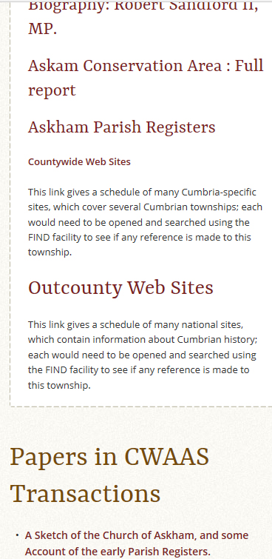
These are just a few of the links from this township page to other resources specific to the place –
including up to ten downloadable papers which have appeared in the CWAAS Transactions over the last 150 years

Slide 18
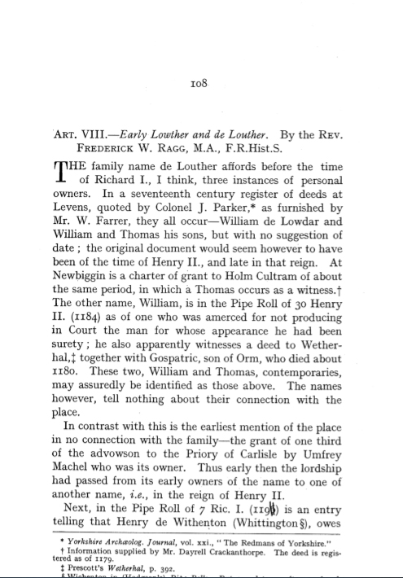
This is the first page of a paper published in 1916 in Transactions, about the family name Lowther, downloaded
as a pdf.

Slide 19
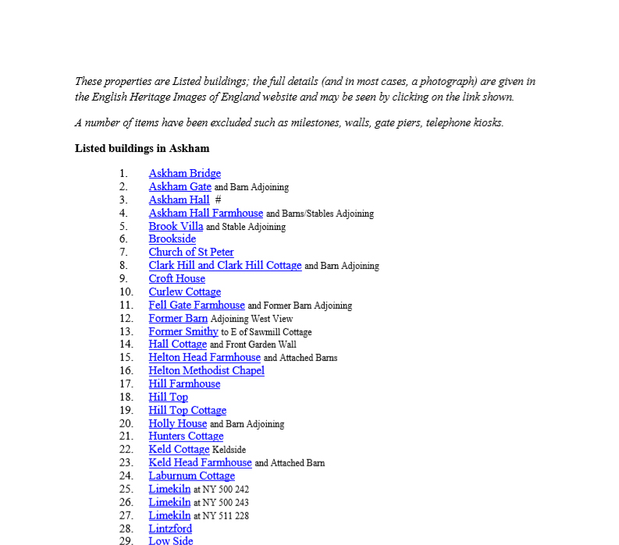
Here for example is a list of all the Listed Buildings in Askham.
Click on the name and it will take you through to the English Heritage website entry for that building

Slide 20
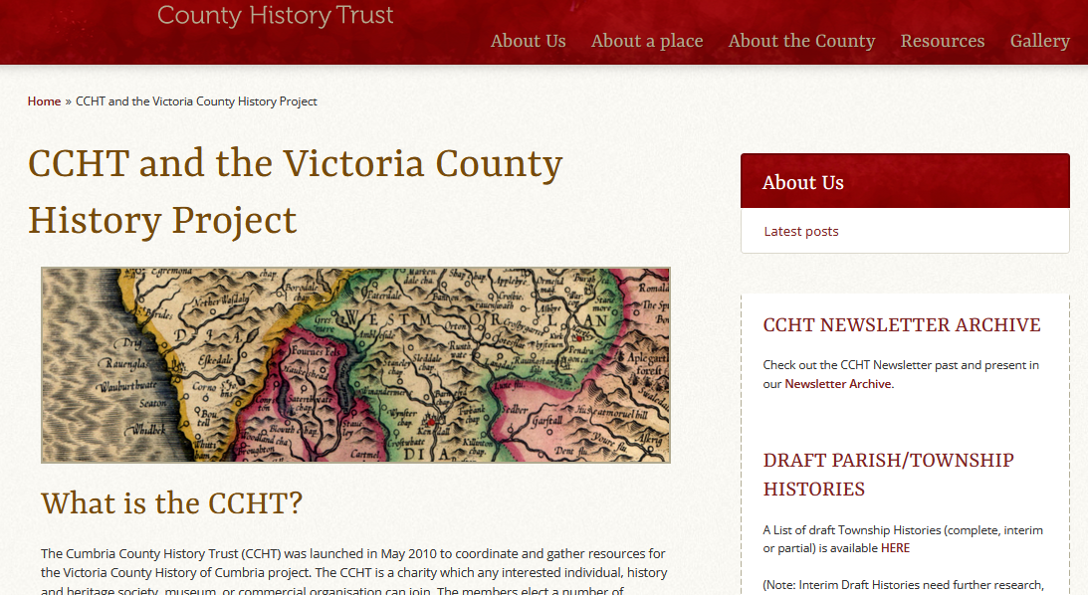
And finally…. Click on the ‘About Us’ tab, and it will take you to a page about the VCH project, information about the CCHT, how to get involved – and you can also access here all the Draft Histories that have been written to date

